Slide 1
Leo Portfolio
T1A2
Xuan Lap (Leo) Tran

Slide 2
Topics
Overviews (Websites)
Overviews – Sitemap, Wireframes
Color schemes
The Actual website and the pages
Web development process
Animations and Components used for engaging purposes
Challenges, ethical issues, and favorite parts
Conclusion

Slide 3
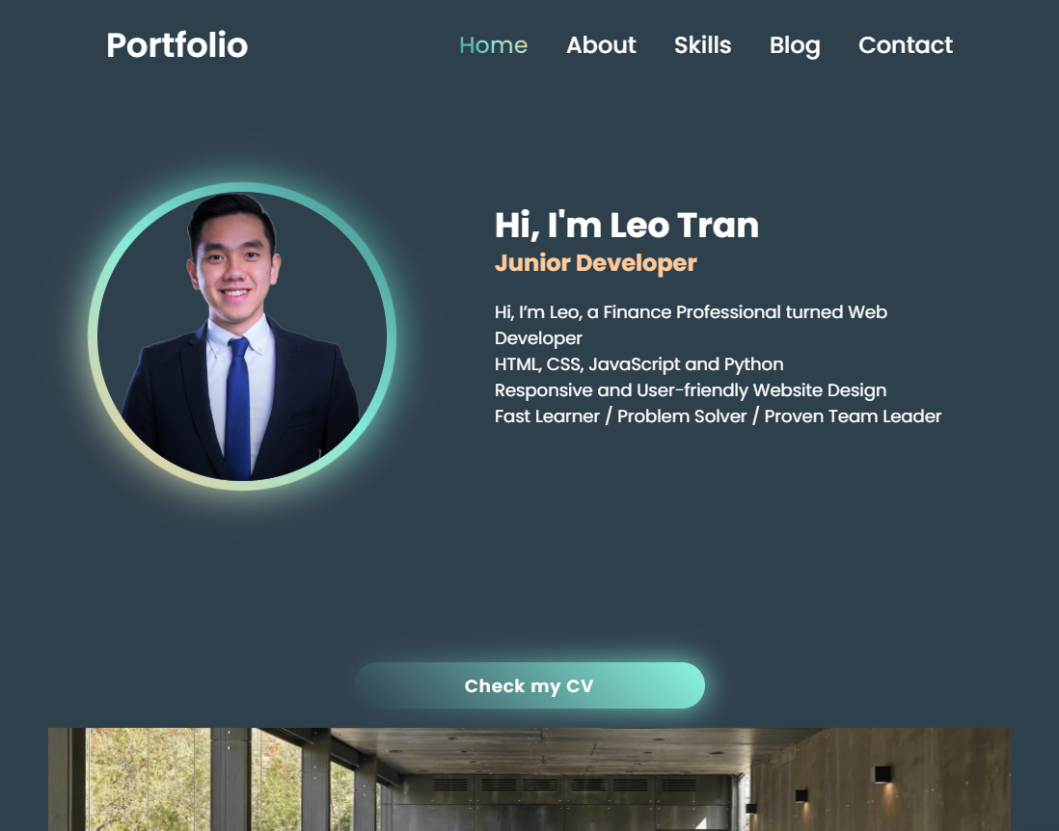
Overviews (Websites – Readme)
https://leo-tran-portfolio.netlify.app/

Slide 4
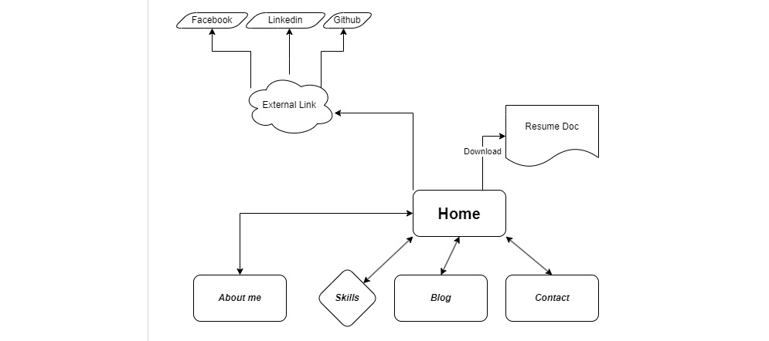
Overviews – Sitemap, Wireframes
https://www.figma.com/file/jLPd5GSDAtgZ7vlAU7Jj8a/Leo-Portfolio?type=design&node-id=0-1&mode=design&t=0UXew3EBFwHsGIN7-0

Slide 5
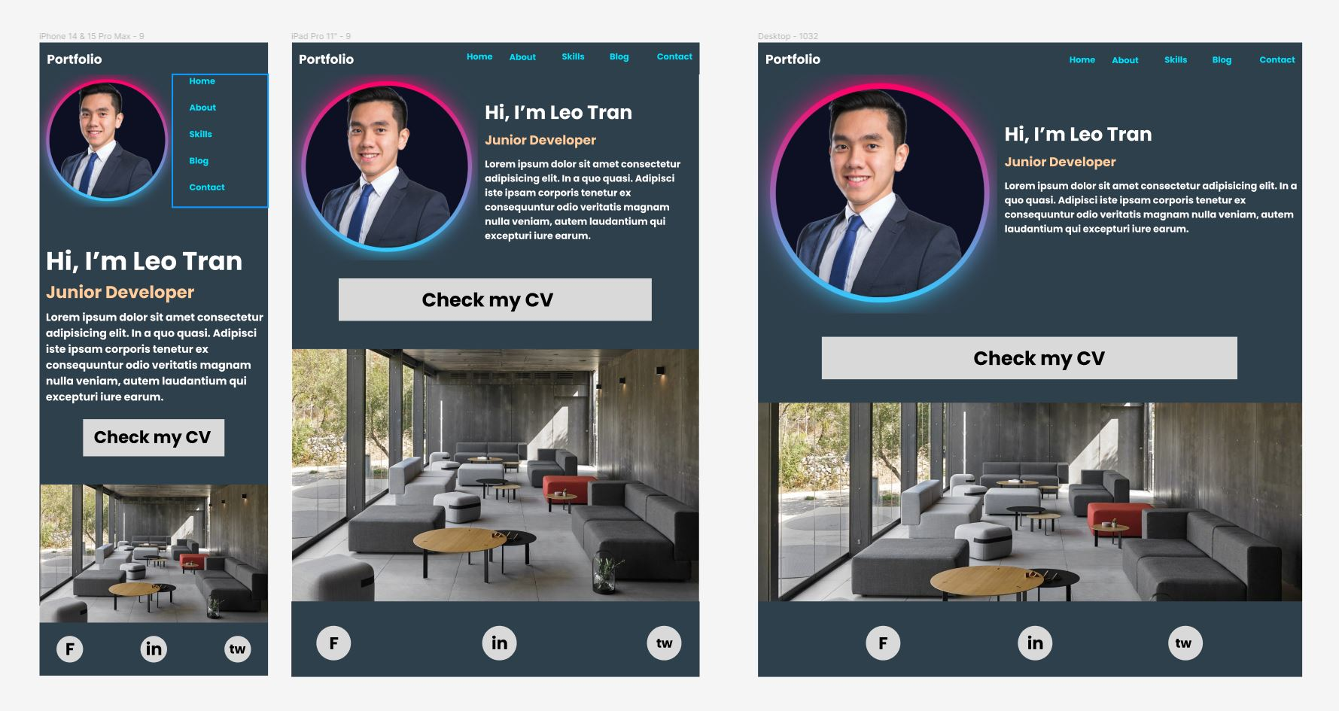
Home page

Slide 6
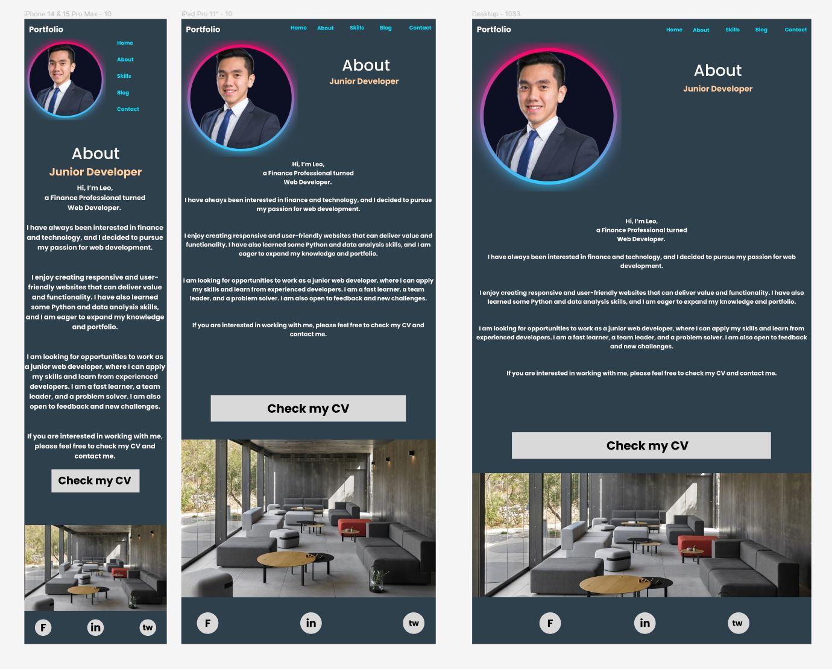
About page

Slide 7
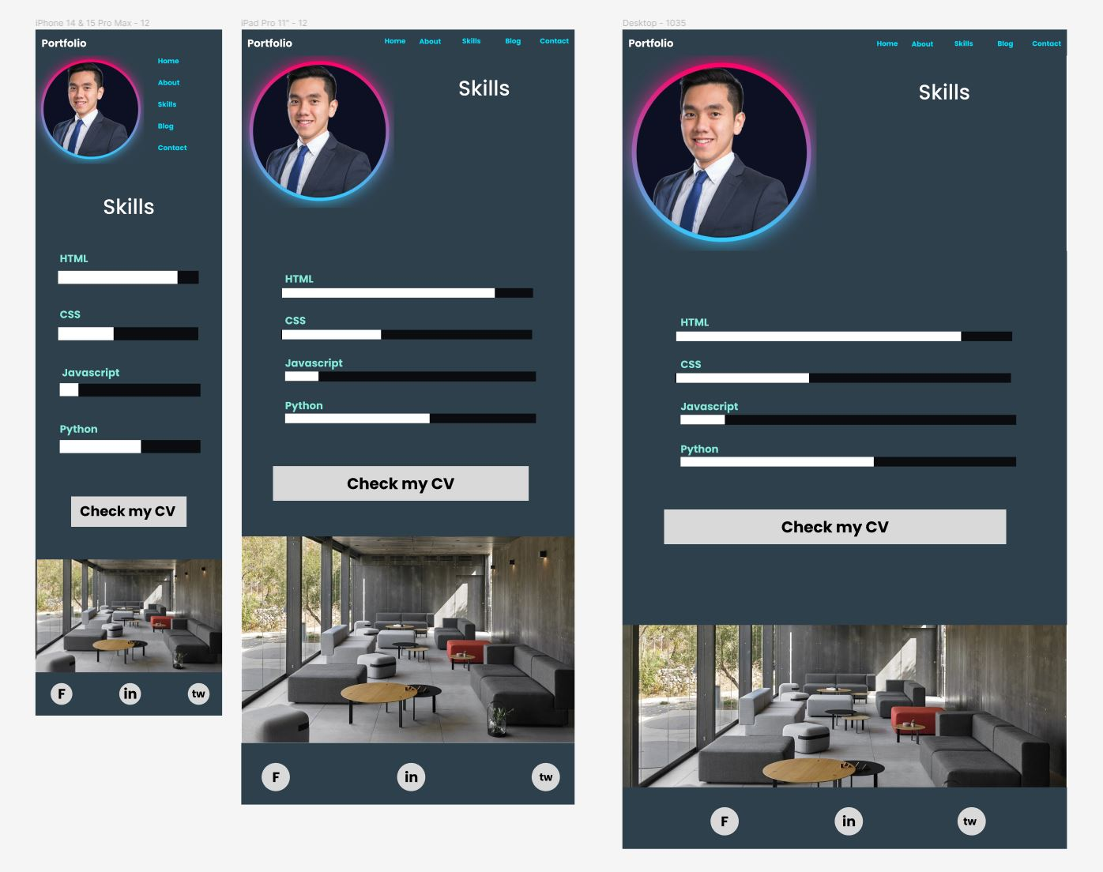
Skills page

Slide 8
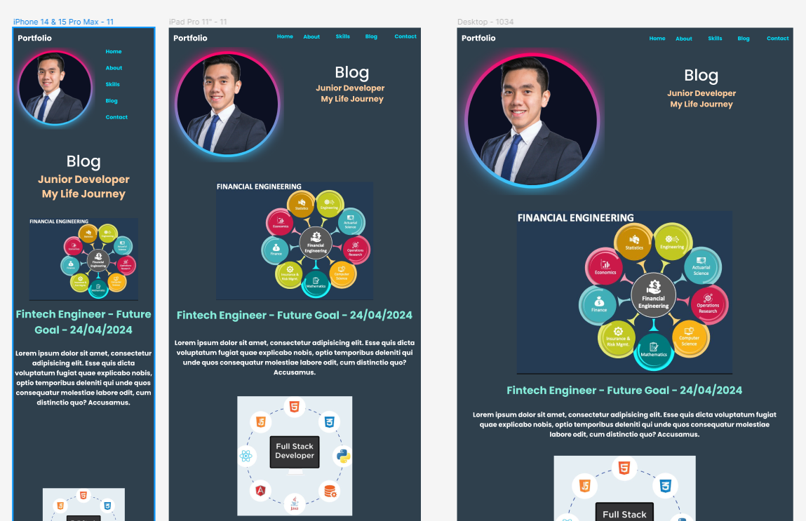
Blog page (top)

Slide 9
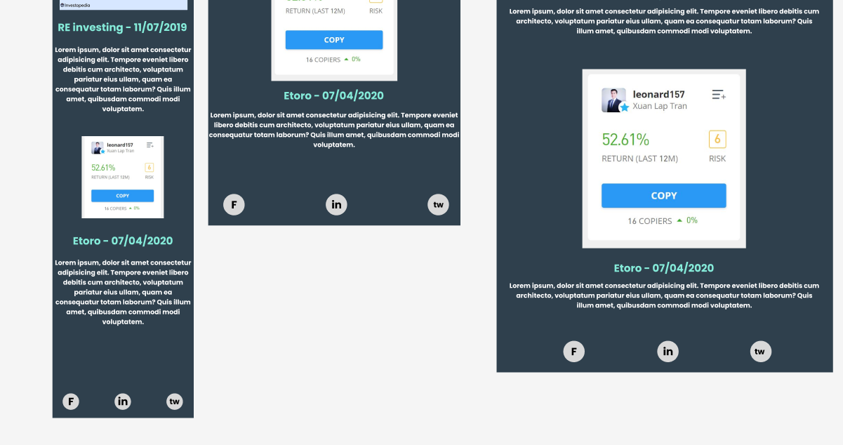
Blog page (bottom)

Slide 10
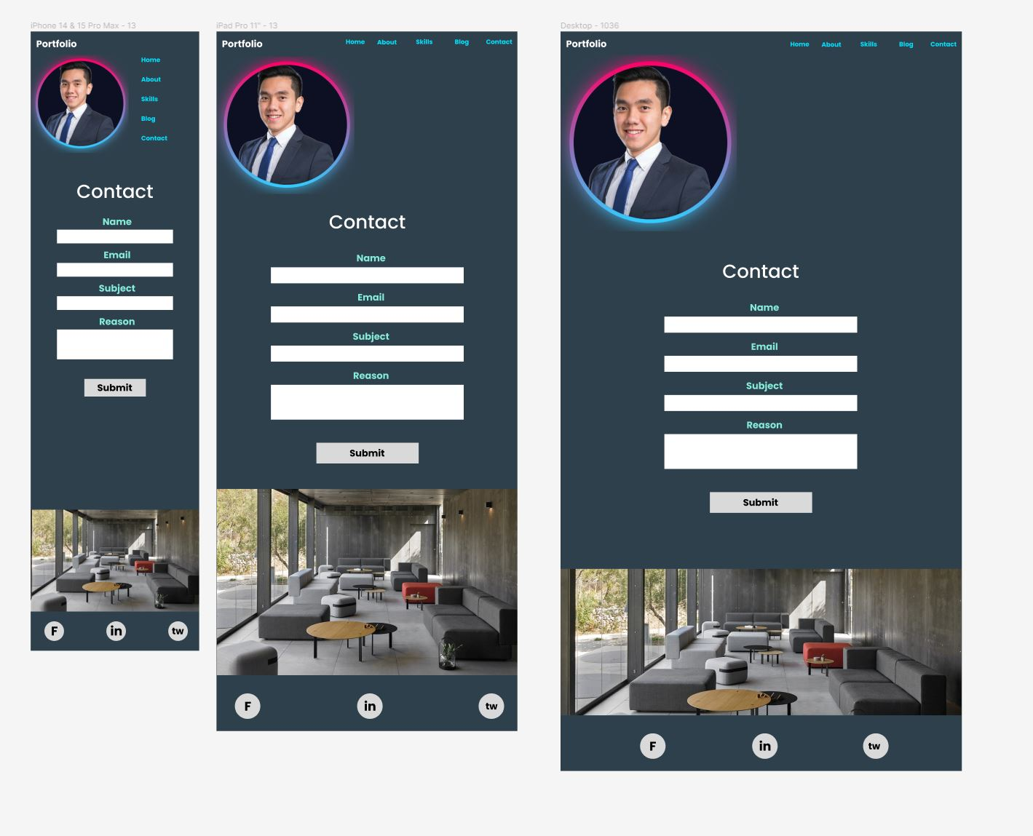
Contact page

Slide 11
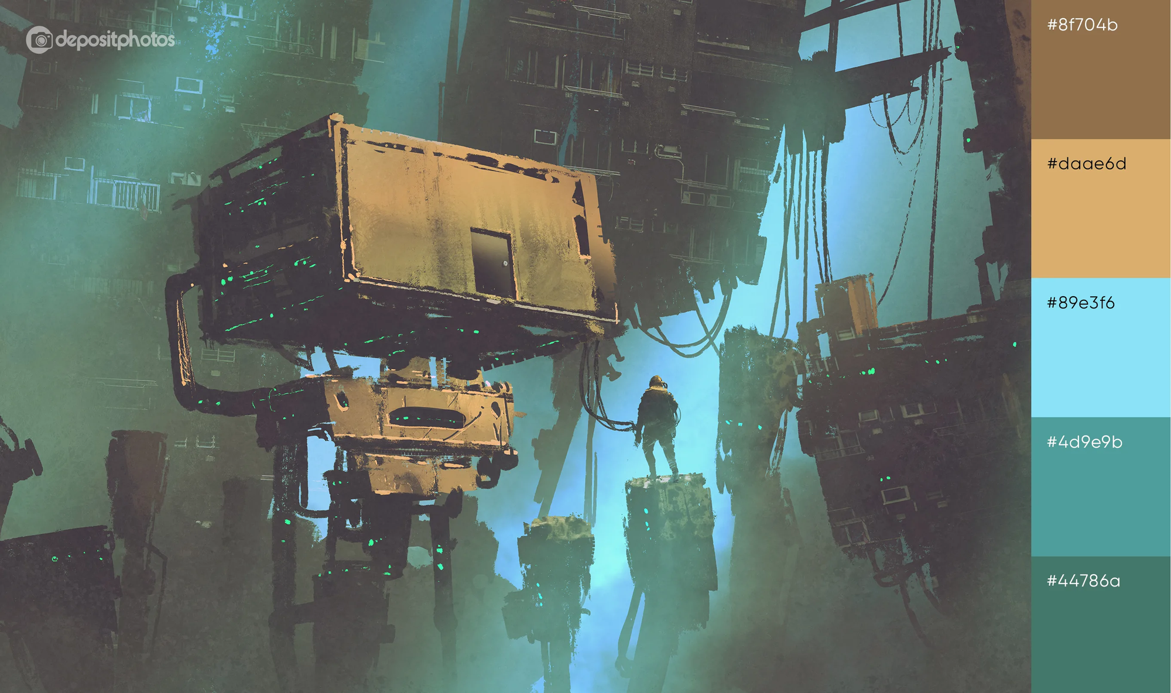
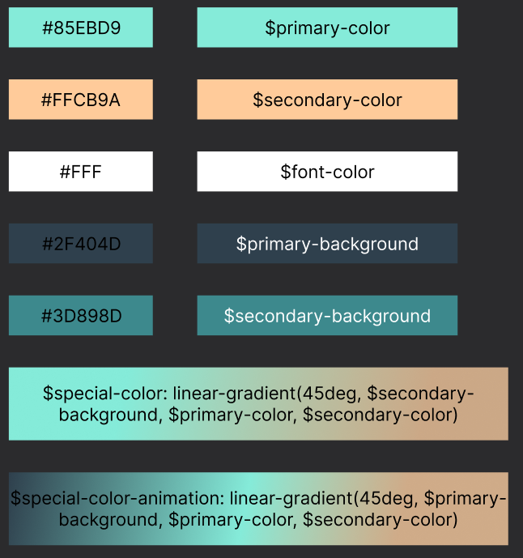
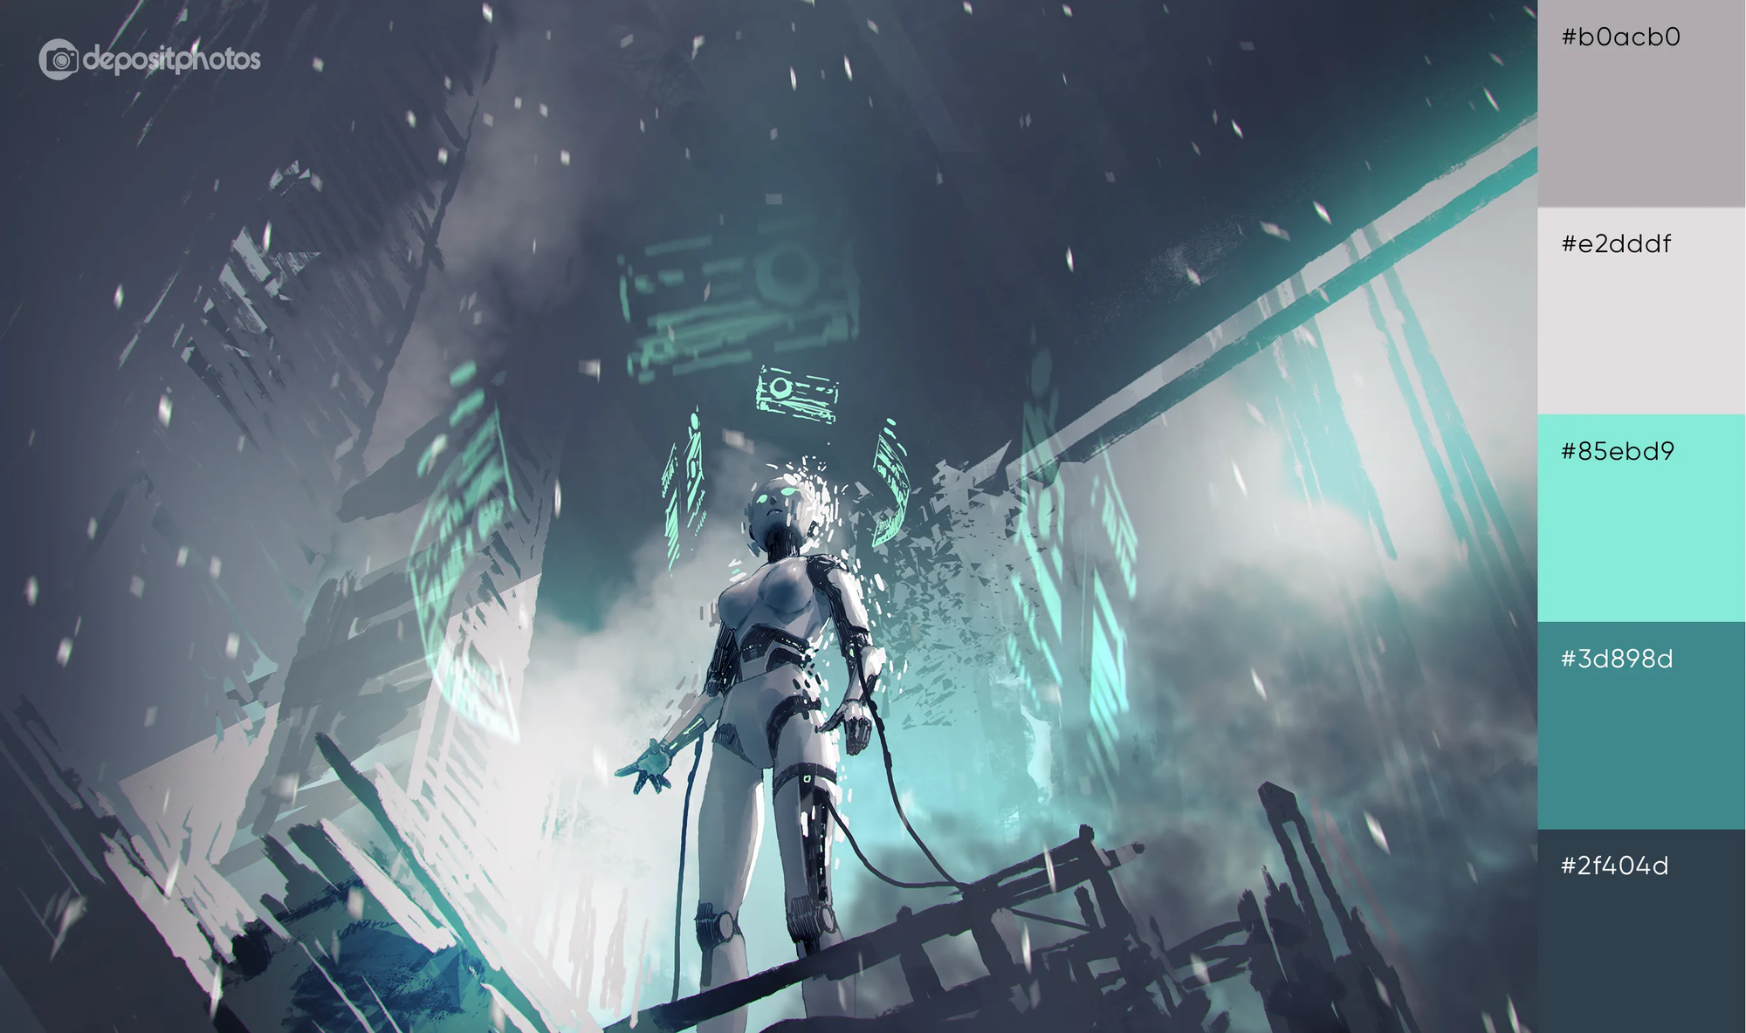
Color schemes

Slide 12
https://leo-tran-portfolio.netlify.app/

Slide 13
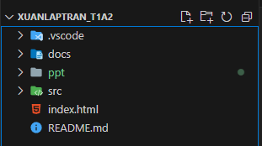
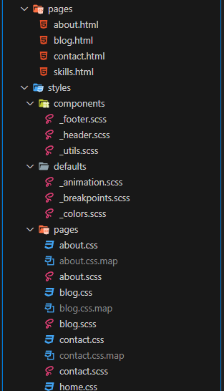
Web development process
1. Sitemap
2. Wireframe
3. Color schemes
4. Start building the website
a. Folder/directory structure: follow the basic requirements of Docs, PPT and SRC, with one more index.html to help with deploying the website.
b. Scss files
c. All page html files in src/pages
d. All scss files in src/styles, organised in separated folders dedicated for different areas for designing:
i. Components folder: footer, header, and utils (for general styling purpose).
ii. Defaults folder: animation, breakpoints and colors.
iii. Pages folder: for different page design styling.
e. Start coding in html and scss

Slide 14
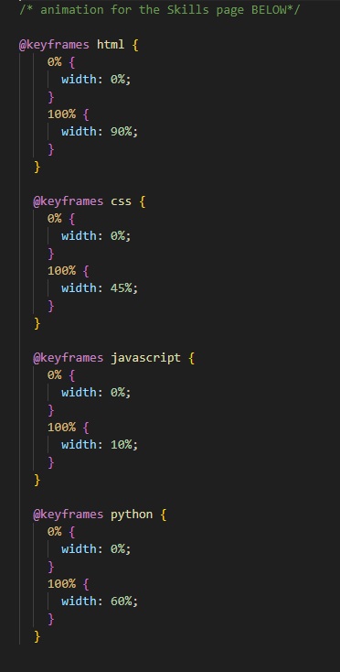
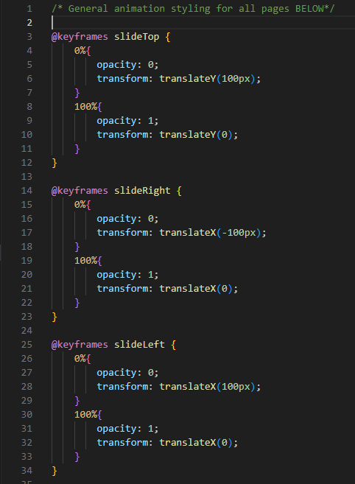
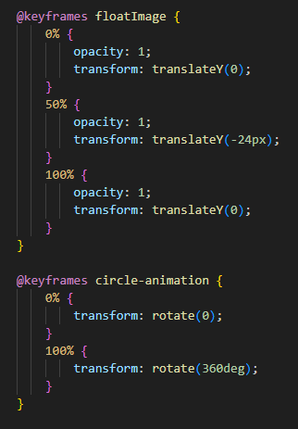
Animations

Slide 15
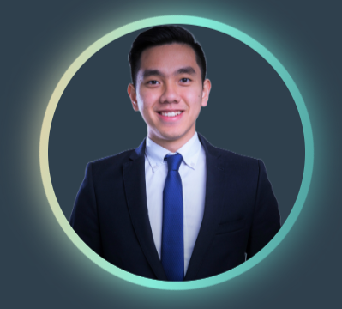


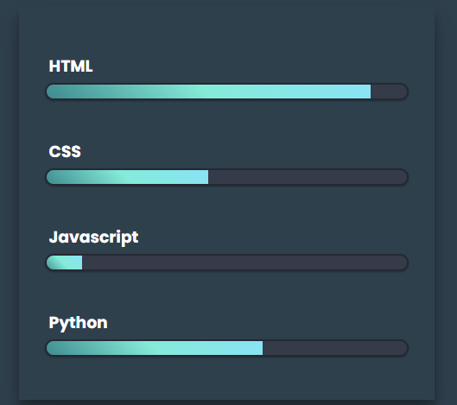
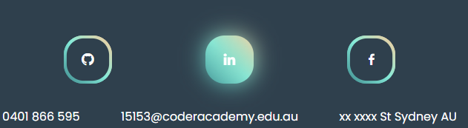
Animations

Slide 16
Challenges, ethical issues, and favorite parts
The most time-consuming part is the idea/layout part: layout, design ideas, animation.
The hardest and most interested part is the animation coding
this is where I do a bit more research on floating animation, transparent styling, sliding animation, progressing bar chart animation and glowing animation.
The most enjoying part would be the color scheme and moodboard, this is where I find many interesting design styles.
The favorite part is obviously the animation! This is where I feel I would spend most of my time in the future to re-visit.
I am aware of and acknowledge the ethical principles that guide research and the use of ChatGPT. I understand that there are potential risks of plagiarism and privacy violation when using AI-generated code. All researches done through search engine and ChatGPT have been done carefully and purely for the purpose of obtaining deeper understanding, knowledge and skills.

Slide 17
Conclusion
To conclude, I have presented:
My portfolio website, which showcases my design style with animation and color scheme.
A walk-through of my design and development process, and
Some of the challenges, ethical issues, and favorite parts of creating this website.
If you are interested in working with me, please feel free to check my CV and contact me. You can also follow me on GitHub, LinkedIn, where I share my projects and progress.

Slide 18
That is the end of my presentation! I hope you enjoy, and Thank you for your time!

